Slide 1
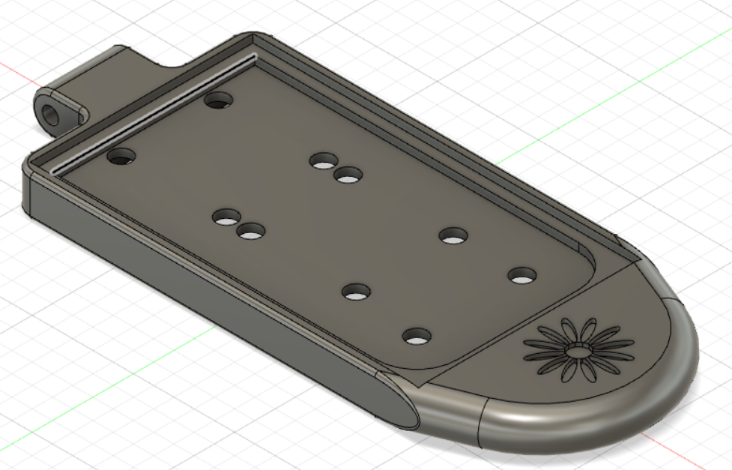
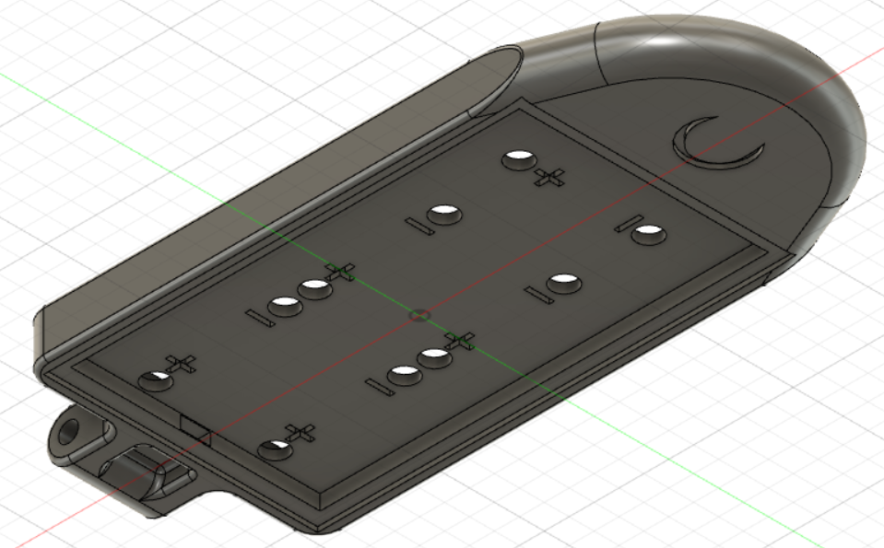
Sensor package Design
Solar Petal
Will hold 5 solar cells that will produce 16 volts.
3 of these items.
Round end to take force from water.
Going to have the wires and cells enclosed.

Slide 2
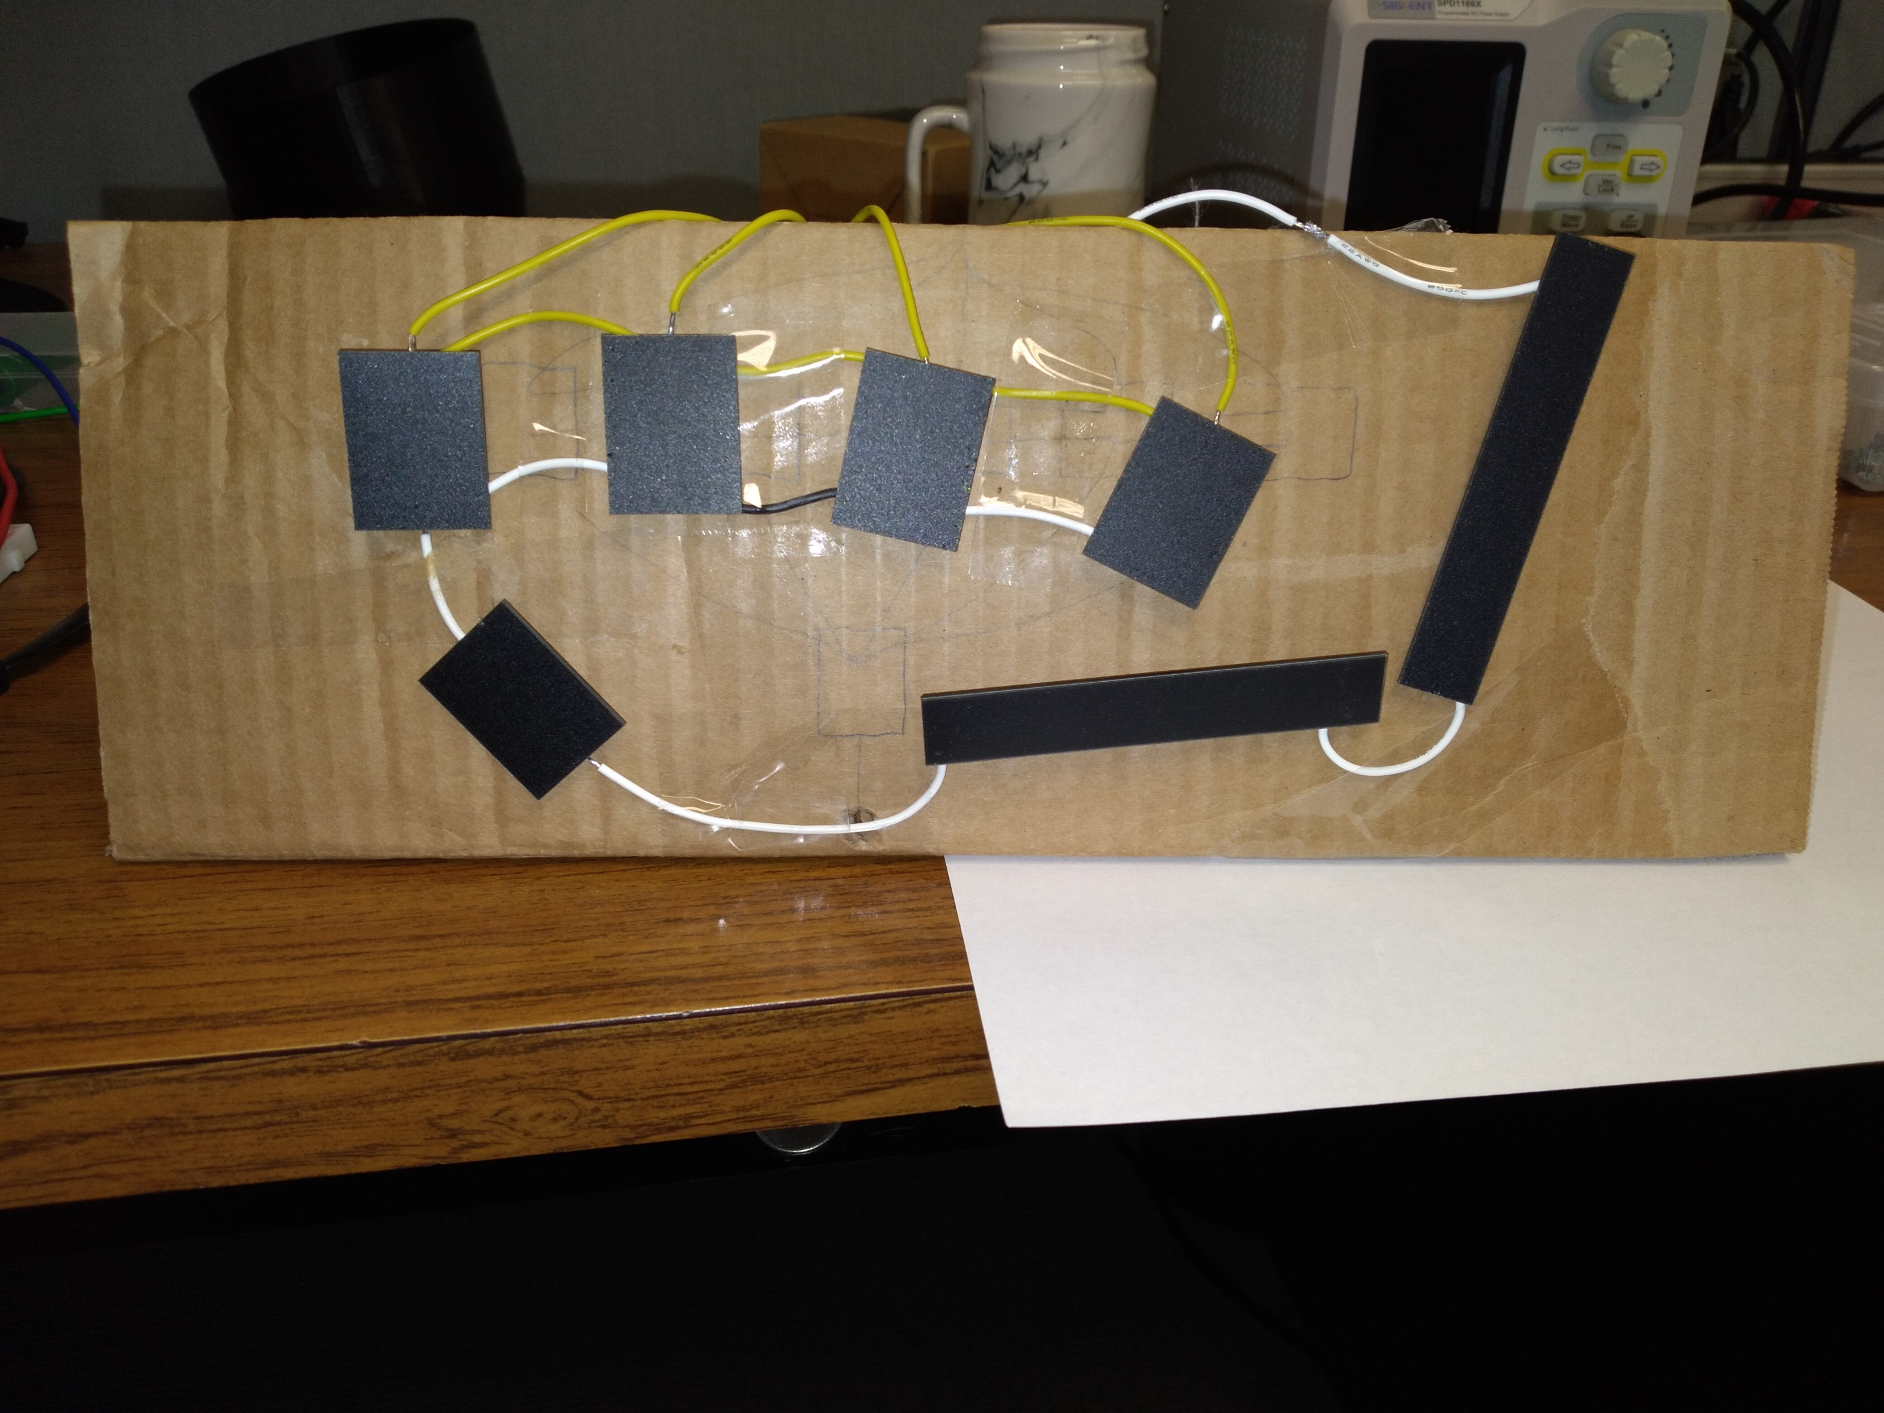
Solar cells cont.
More solar cells were added to the design.
Volts: 25 volts

Slide 3
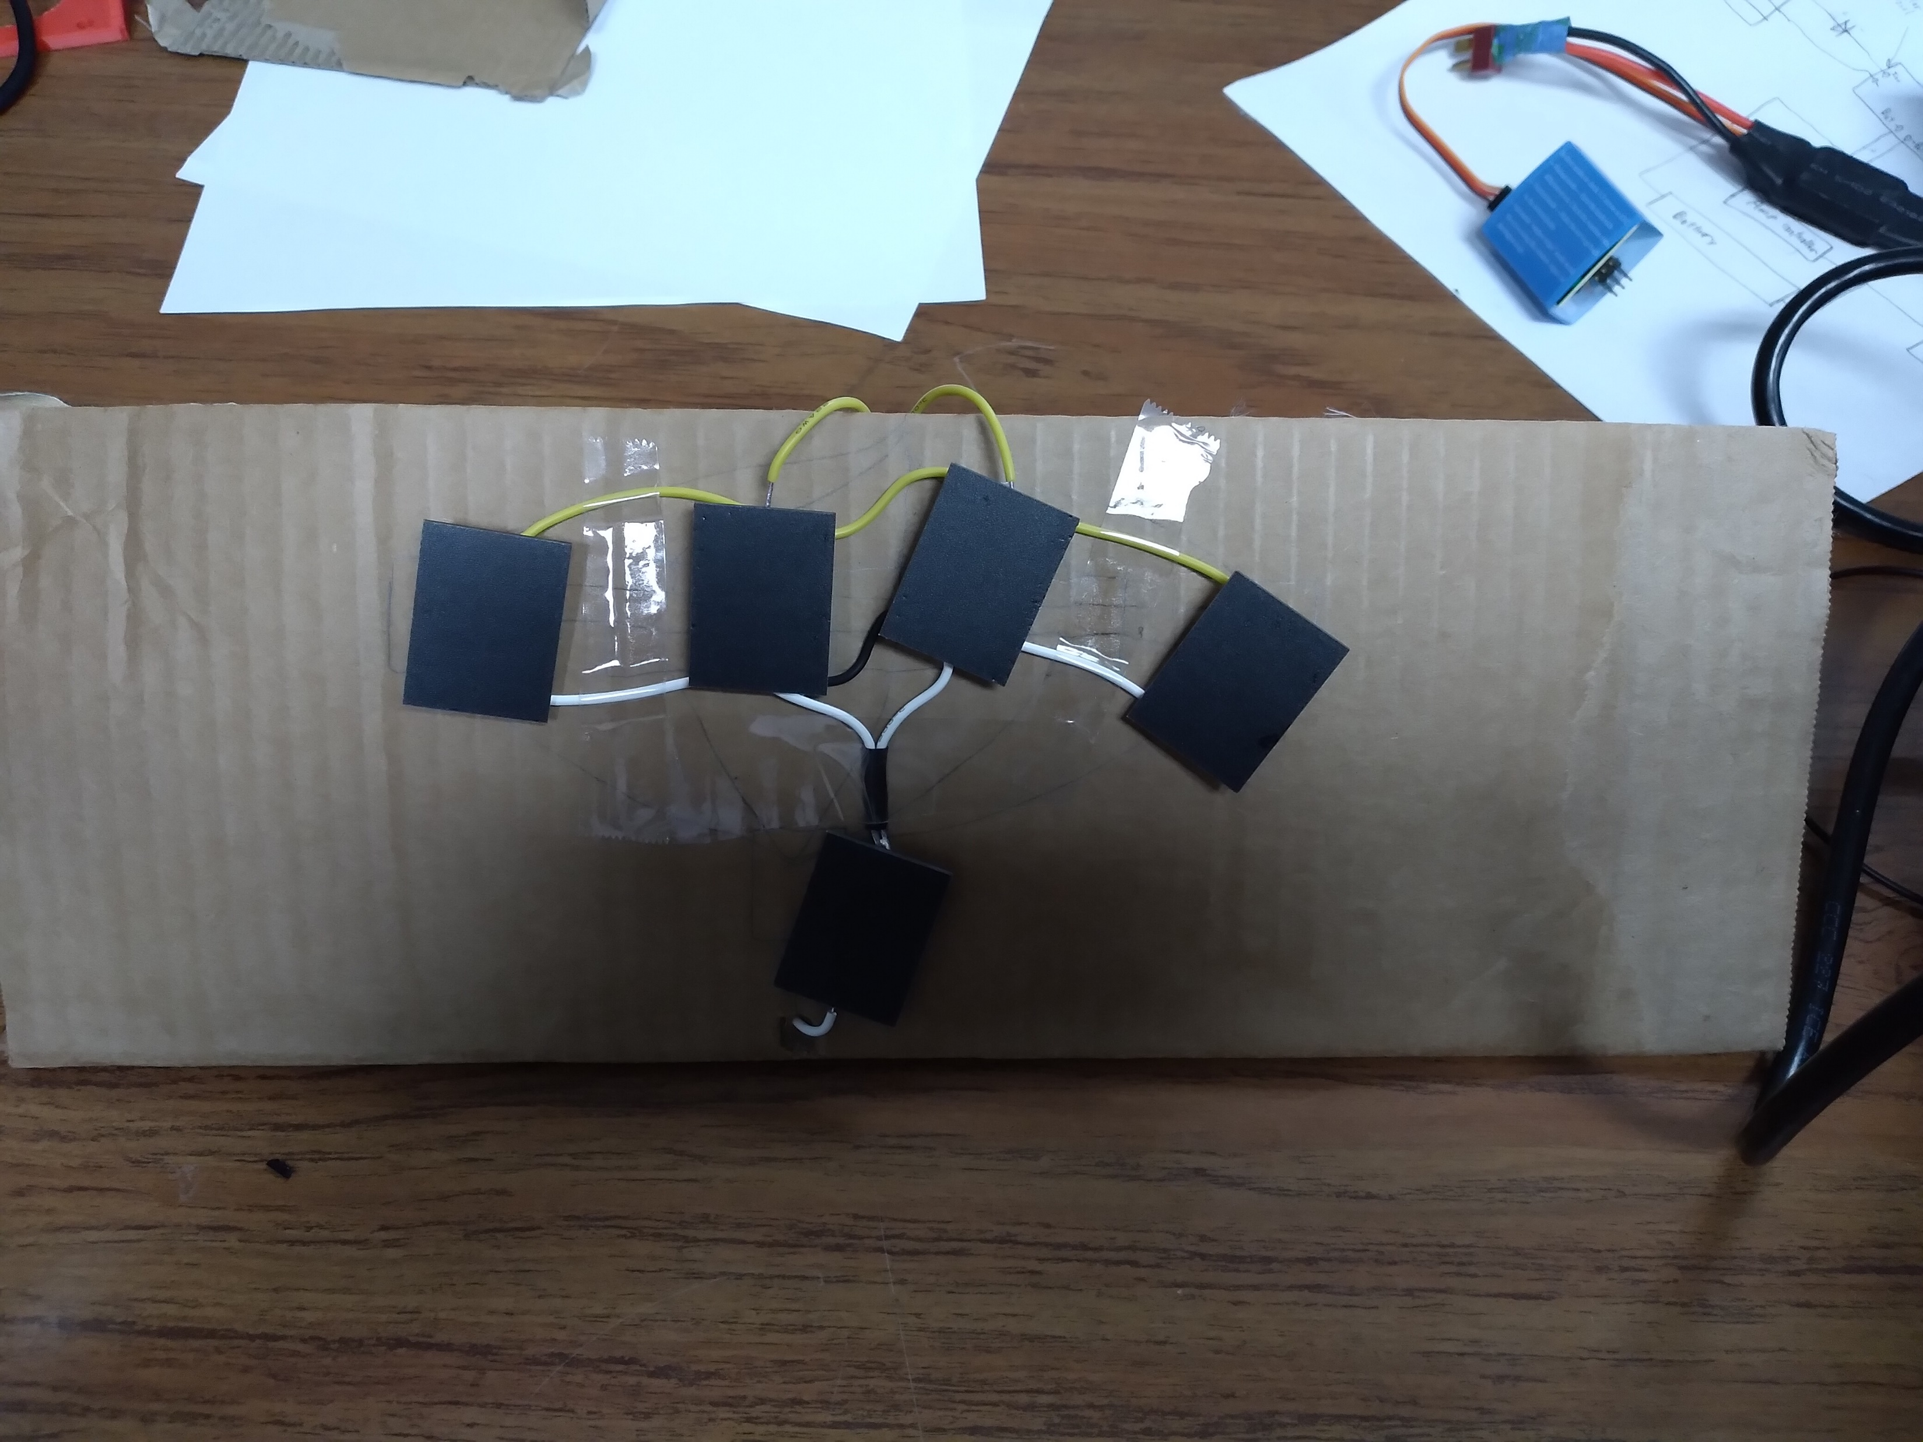
Solar Cells
Soldered together solar cell in parallel and series.
Volts: 16 V
Amps: 7.9 milliamps.

Slide 4
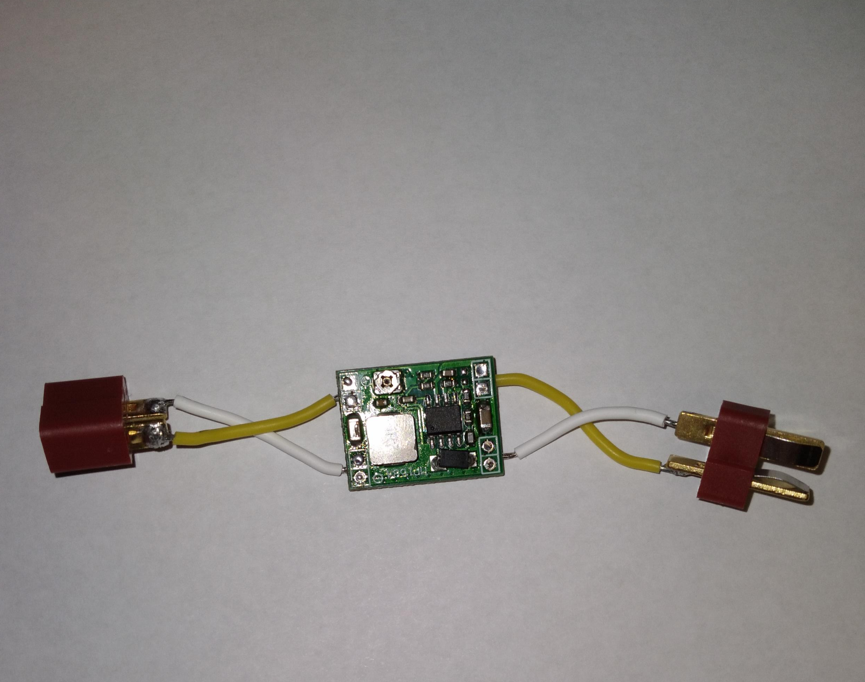
Solar Cells update
Solar cells have been given DC step-down.
To decrease voltage and increase amperage.
The battery and solar cells both have DC step-down.
Voltage: 5V.
Amps: 15 milliamps.

Slide 5
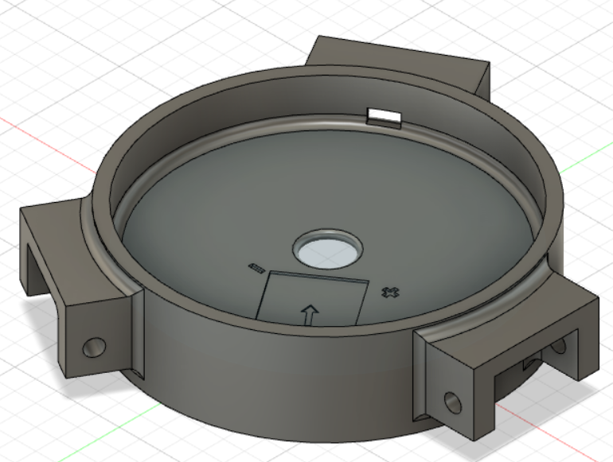
Sensor package design cont.
Solar connecter
Will connect all solar petals to the sensor package.
Will have metal top for the magnets.
A DC stepdown to drop the voltage from 16 to around 5-6 Volts.
Current 15 milliamps.

Slide 6
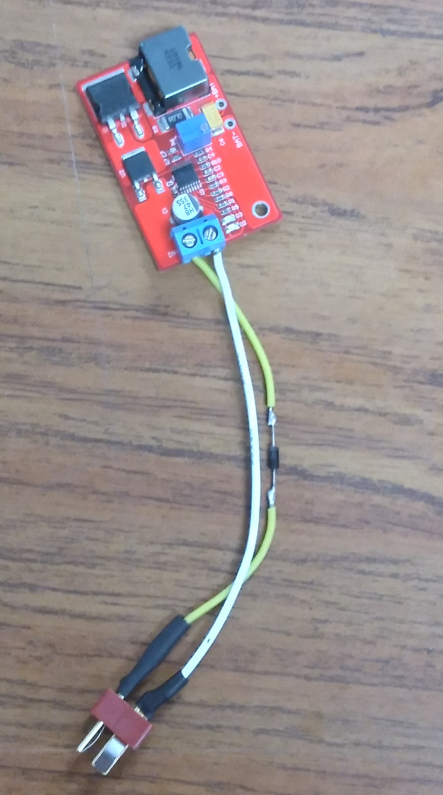
Battery charger
Will be connected to the solar cells.
The diode is used to prevent voltage backlash.
Will charge a battery from the solar cells.

Slide 7
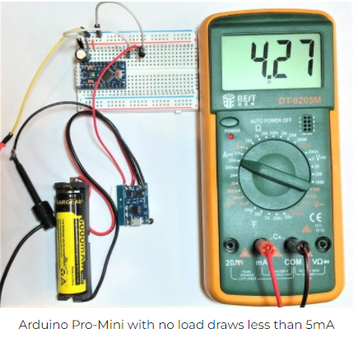
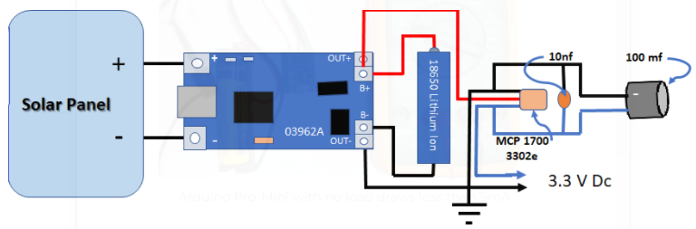
Battery Charging System
https://www.circuitbasics.com/how-to-use-solar-panels-to-power-the-arduino/

Slide 8
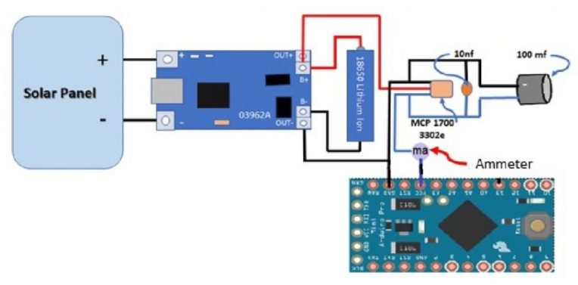
SChematic

Slide 9
Youtube Video example project
https://www.youtube.com/watch?v=37kGva3NW8w

Slide 10
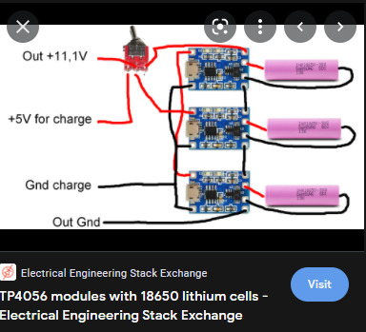
Setup for more batteries

